Slide 1


Happiness Explained: An Exploration of Happiness Scores by Country
Members:
Arlette Varela
Nathan Bolt
Nirupama Shankar
Teshanee Williams

Slide 2
Motivation & Summary
Core Message
According the the world happiness report there are several subjective well-being measures (SWB) that were studied. What we wanted to examine was the different factors to determine the correlation of each of these with overall happiness. We also wanted to see which of these is most likely to influence happiness.
Notes:
Nathan’s Slide

Slide 3
Motivation & Summary Cont.
Questions:
Which countries had the lowest happiness score? highest happiness score?
What are the outliers for the measures of SWB: social support, healthy life expectancy, generosity, freedom to make life choices, GDP per capita, and perception of corruption? How do they compare?
Which of the measures of SWB (i.e., social support, healthy life expectancy, generosity, freedom to make life choices, GDP per capita, and perception of corruption) are most highly correlated with a higher happiness score?
Which of these measures are most likely to influence the happiness score?
What motivated us to answer these questions?
We wanted some positivity
Also interested in corruption

Slide 4
Motivation & Summary Cont.
Were we able to answer the questions to our satisfaction?
Answer
Brief summary of our findings
We found that GDP, Social Support, Healthy Life Expectancy had strong correlations
Morevoer, all SWBs were found to be statistically significant except Generosity
(p-value < .05 = statistically significant)

Slide 5
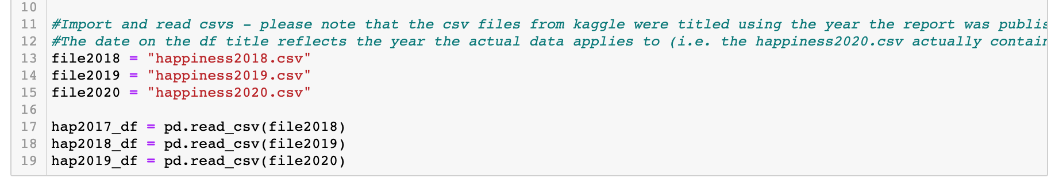
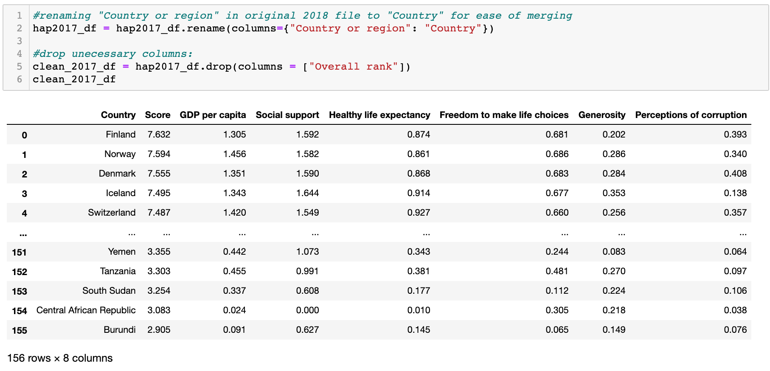
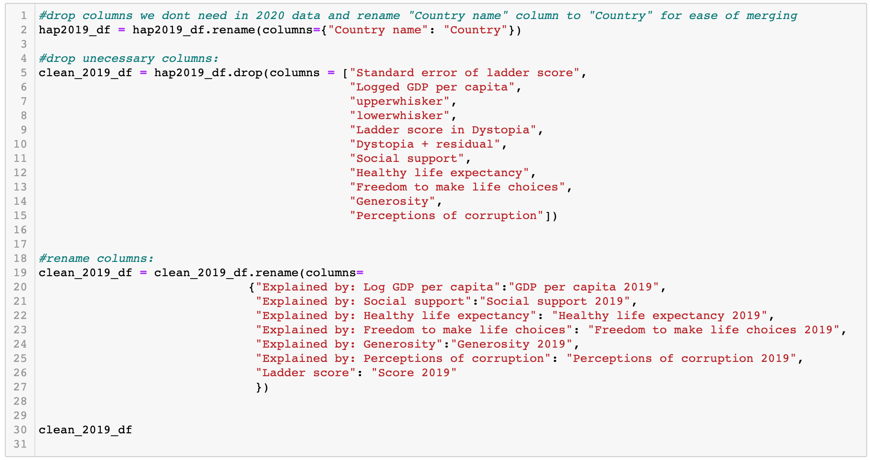
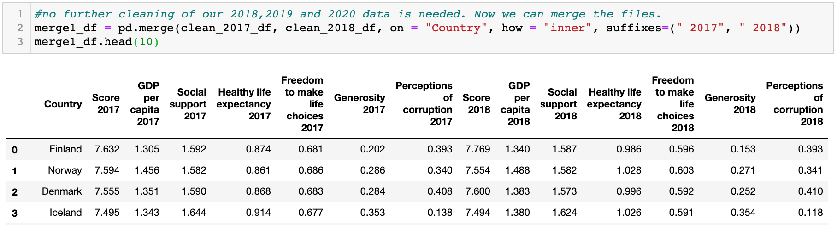
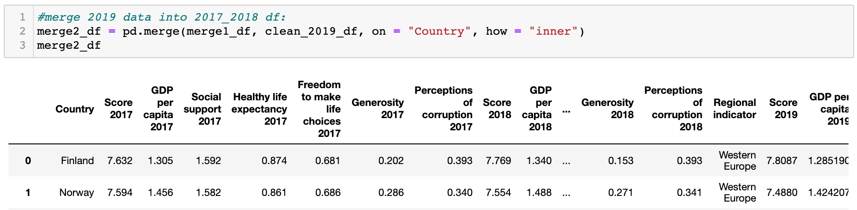
Data Cleanup & Exploration
Describe
We discovered a decades worth or data from Kaggle and imported the three most recent years of data as CSVs into a Jupyter Notebook.
Clean-up
Merge
Once all three datasets were uniform, we merged by country into one large dataframe.
Reorder
Lastly, we reordered and titled the columns chronologically and sorted by happiness score descending.
We compared our three datasets and dropped unnecessary columns. We unfortunately lost a few countries due to not being present in all three data sets.
Notes:
Arlette’s Slide

Slide 6
Questions & Data
Top 10
Elaborate on the questions we asked, describing what kinds of data we needed to answer them, and where we found it.
Q1: Which countries had the lowest happiness score? highest happiness score?
The average over the last three years shows Finland as having the happiest overall score. Rounding out the top five is Denmark, Norway, Switzerland, and Iceland. Inversely, the lowest happiness scores fall on South Sudan, Afghanistan, and Central African Republic.
Bottom 10

Slide 7
Questions & Data Q1 cont.
Q1: Which countries had the lowest happiness score? highest happiness score?
The average over the last three years shows Finland as having the happiest overall score. Rounding out the top five is Denmark, Norway, Switzerland, and Iceland. Inversely, the lowest happiness scores fall on South Sudan, Afghanistan, and Central African Republic.

Slide 8
Questions & Data: Cont.
Q2: What are the outliers for the measures of SWB: social support, healthy life expectancy, generosity, freedom to make life choices, GDP per capita, and perception of corruption? How do they compare?
Perception of corruption saw the most outliers at the high end. A high rating is interpreted as less corruption. The mean fell around .12

Slide 9
Questions & Data: Cont.
Q3: Which of the measures of SWB (i.e., social support, healthy life expectancy, generosity, freedom to make life choices, GDP per capita, and perception of corruption) are most highly correlated with a higher happiness score?
We found that GDP had the highest correlation at .81 with Social Support and Healthy Life Expectancy rounding out the top three.
All other SWBs were moderate to weak correlations.

Slide 10
Questions & Data: Cont.
please add all scatterplots and maybe the function for our regression and scatterplots here…?

Slide 11
Questions & Data: Cont.
Q4: How do the measures of SWB influence the happiness score?
We found that GDP per capita, Social Support, Health Life Expectancy, Freedom to make Life Choice, and Perception of Corruption had a significant effect on the Happiness score. Generosity was not significant.
Freedom to make life choices affects the happiness score more than any other variable because each unit increase leads to a higher happiness score by 1.33%. Generosity has the lowest unit increase

Slide 12
Data Analysis
Discuss the steps you took to analyze the data and answer each question you asked in your proposal
Present and discuss interesting figures developed during analysis, ideally with the help of Jupyter Notebook

Slide 13
Discussion:
Discuss your findings. Did you find what you expected to find? If not, why not? What inferences or general conclusions can you draw from your analysis?

Slide 14
Post Mortem:
Discuss any difficulties that arose, and how you dealt with them:
Lack of a multivariable analysis: We had only compared each independent variable to happiness in our regressions and correlations.
Discuss any additional questions that came up, but which you didn't have time to answer: What would you research next, if you had two more weeks?

Slide 15
Open floor Q & A
Please be nice, our study found we are not that happy…nor generous.

Slide 16
Sources and other docs:
Kaggle
World Happiness Report
Github
Write-Up
Presentation Timeline

